Slide 1

Presented By: Chunjie Zheng
郑纯洁
April. 2017

Slide 2
内容
自我介绍
Women in IT
纵观全球IT Industry
中外IT产业
中外思维差异
中外企业文化

Slide 3

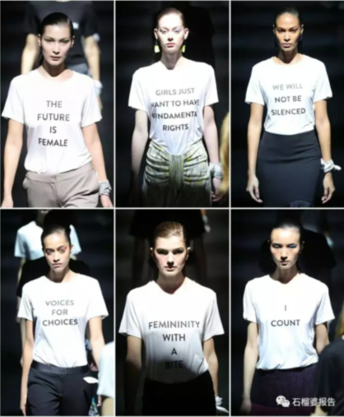

Women in IT

Slide 4

全球IT industry
Innovation
Harvard Bubiness Review showed organisation under-perform 34% in financial term where women are underrepreseted
popularity in IT industry worldwide
talent is needed

Slide 5





国内外IT industry差异
电子商务 | 人工智能
软件开发 | WIT

Slide 6
思维模式差异
teamwork vs. independent work
responsibility
individualism
  导致工作模式不同

Slide 7
中外企业文化差异
企业环境不同
  organisation culture
  training
文化差异
  privacy & security
  shareholders

Slide 8

Any Questions？

